Slide 1
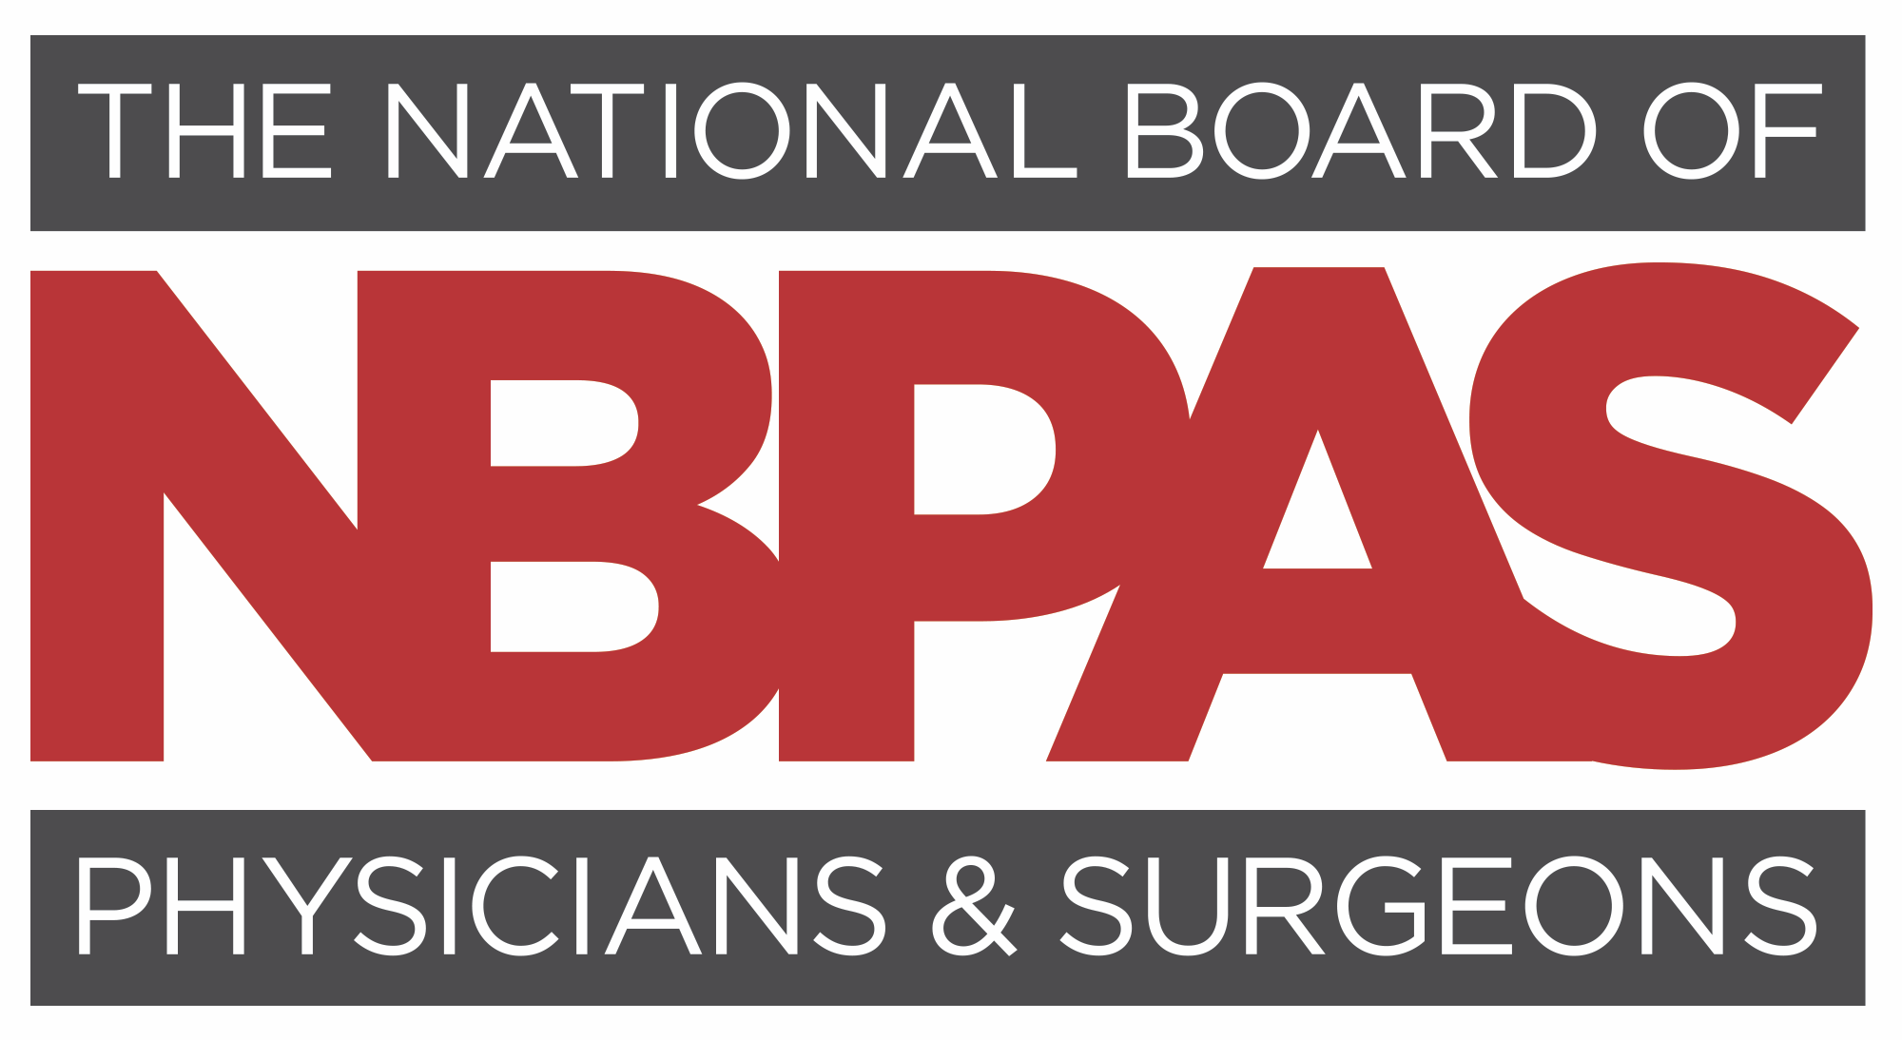

Slide 2
Brief Overview
Nonprofit
Founded in 2015 by
20 physicians, thought leaders in
clinical and academic medicine
Goal
Support continuous and rigorous lifelong learning, clinical excellence, professionalism, and patient care through evidence-based CME
Requirements
streamlined, less burdensome, specialty specific, designed to reduce physician burden and burnout
Certifies 11,000+ physicians
in all 50 states and at hospitals and health systems, telemedicine; adding 100-300 new physicians/month
Provides competition and choice in continuing certification

Slide 3
Why add NBPAS Certification in Addition to ABMS MOC?
NBPAS provides a more clinically relevant learning pathway tailored to patient needs
AMA PRA Cat 1 CME™ provides real-time education from clinical experts regarding emerging medical trends, rapidly evolving data, and global events (i.e., COVID-19)
NBPAS led by a board of practicing physicians from esteemed medical institutions.
NBPAS does not agree with and prohibits the grandfathering of physicians from educational requirements
No single entity should be able to wield an expensive and arduous process that burdens the medical industry and raises the cost of health care. Competition is good for physicians and their patients.

Slide 4
Common
Questions and Answers
for Hospitals, Health Systems, Medical Executive Committees
and Medical Staff Offices

Slide 5
Is NBPAS an “Accepted” Board Certification?
NBPAS meets national accreditation standards for:
Hospitals: The Joint Commission, DNV, CIHQ, ACHC
Health Plans: NCQA and URAC
Primary Source Verification (PSV) performed for all physicians
Accepted at nearly 200 hospitals, health systems, telemedicine companies, private practices, payers, and growing steadily

Slide 6
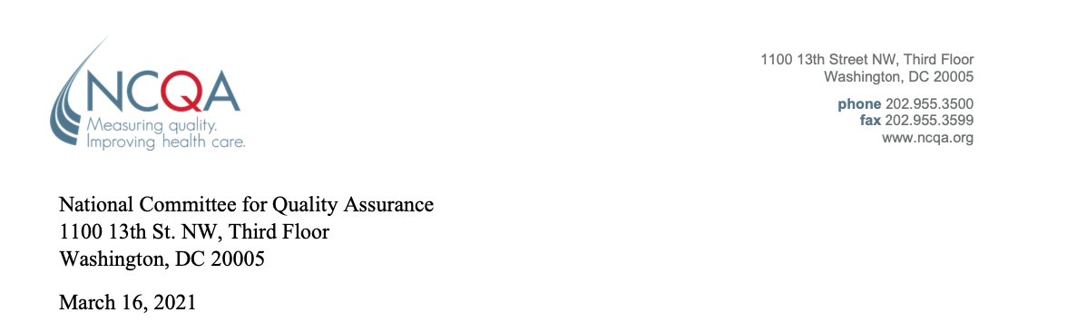
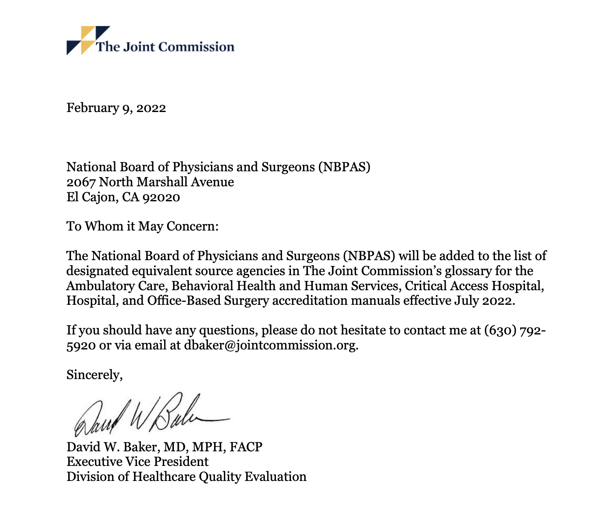
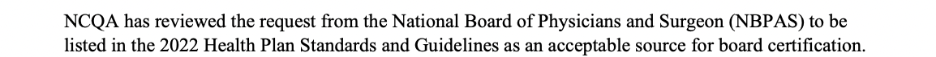
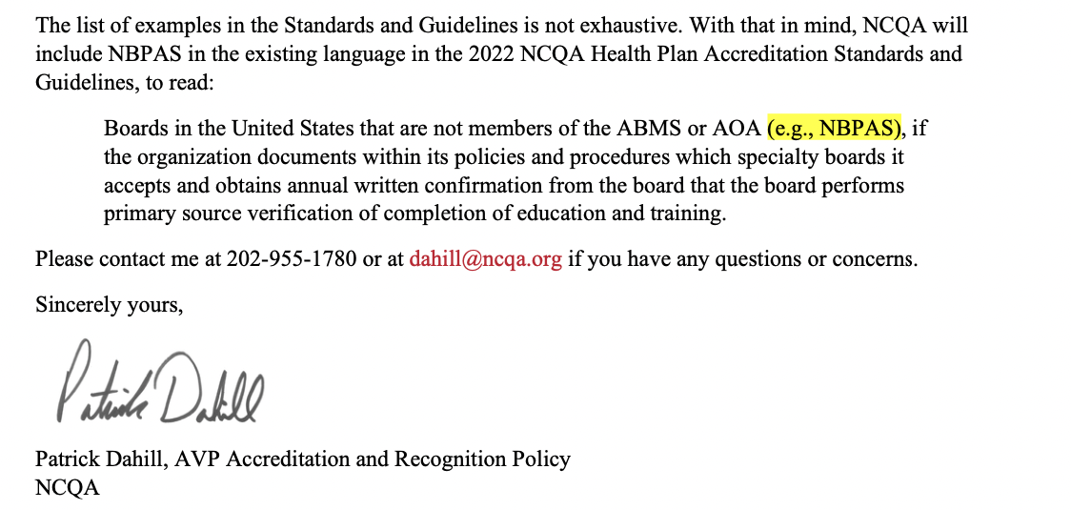
NBPAS Added as a “designated equivalent source agency” by TJC and an “acceptable source for board certification” by NCQA.

Slide 7

What About Health Insurance Companies?
Widespread and Growing Recognition
Meets national accreditation standards by CMS-deemed agencies for health plans (NCQA, URAC)
Important: These standards allow hospitals to determine internal physician credentialing requirements.

Slide 8
What are NBPAS Clinical and Professional Requirements?
ACGME-accredited residency and/or fellowship
Initial board certification through an ABMS/AOA member board in the applied-for specialty
Minimum 50 AMA PRA Category 1 CME™ (100 CME if previous certification lapsed)
Active/unrestricted medical license
Outpatient/hospital privileges (certain surgical specialties)
2-year recertification cycle
$94.50/year regardless of number of specialties, 72% savings (on average)

Slide 9
Will NBPAS Help Reduce Costs?
ABIM
NBPAS
Annual MOC/LKA fee: $220
1 sub-specialty: $120
Exam if LKA/MOC failed: $700*
*Addition to annual fees. Travel, lodging, and other indirect expenses not included in exam fee.
Annual NBPAS cost: $94.50
10-year total = $3,400
10-year total = $945
72% AVERAGE SAVINGS
with NBPAS

Slide 10
AMA PRA Cat 1 CME now counts as ABIM MOC points
Hi Dr. Smith,
All ABIM MOC credit earned through ACCME accredited educational providers is also CME credit, also know as AMA PRA Category 1 credit. In most cases our transcript is acceptable as evidence of CME credit, whether it is submitted as ABIM credit or AMA PRA Category 1 credit.
Thank you,
ACCME
Email from ACCME customer service to a physician, July 20, 2023

Slide 11
Still No “Level A” Evidence Supporting ABMS
MOC pathway
PubMed Literature Review
26
focused on
outcome metrics
139
STUDIES
comparing time limited and
time-unlimited board certification
  Reduction in complications
  Reduction in medical errors
  Improved patient safety
  Improved quality of care
  Improved patient outcomes

Slide 12
MOC requirement and ambulatory care-sensitive hospitalizations
(JAMA 2014 Dec 10;312(22):2348-57 Gray et al.)
Preventable hospitalizations through better quality and access to care
Significant impacts to hospital costs
Compared outcomes of 154,045 patients
No differences associated with participation in MOC
956 physicians time-limited (MOC required), 974 time-unlimited (MOC not required)

Slide 13
Association Between Physician Time-Unlimited
vs Time-Limited Internal Medicine Board Certification and Patient Care Quality
(JAMA. 2014;312(22):2358-2363. Hayes, et al)
Four VA hospitals, 68,213 patients
Ten primary care performance measures
  colorectal screening rates
  diabetes with glycated hemoglobin (HbA1c level) less than 9.0%
  diabetes with blood pressure less than 140/90 mm Hg
  diabetes with LDL cholesterol level less than 100 mg/dL
  hypertension with blood pressure less than 140/90 mm Hg
No differences in outcomes for patients cared for by internists with time-limited (MOC) or time-unlimited (no MOC) certification for any performance measure
  thiazide diuretics used in multidrug hypertensive regimen
  atherosclerotic coronary artery disease and LDL-C level less than 100 mg/dL
  post-myocardial infarction use of aspirin
  post-myocardial infarction use of β-blockers
  congestive heart failure (CHF) with use of angiotensin-converting enzyme (ACE) inhibitor

Slide 14
Association Between Board Certification, Maintenance
of Certification, and Surgical Complications in the United States
(Am Journal Med Quality Nov/Dec 2019; 34 (6): 545-552)
Patient outcomes study
Medicare claims for 1.9 million
elective surgical procedures
14,598 physicians
(64% orthopedics, 17% general surgery, 11% urology, 7% neurosurgery)
Completion of MOC was NOT associated with differences in complication rates

Slide 15
Quality of physician care is measured and assessed more than ever before

Slide 16
Typical Physician Quality Measures
Clinical
Grand rounds, monthly
Case conferences, weekly
Case reviews, monthly
Procedure-specific cases reviews
Surgical case reviews, weekly to monthly
Specialty council meetings, quarterly Morbidity/mortality reports (adverse event reporting + troubleshooting)
Weekly Extensive data collection added and compared to national databases (i.e, ACC Cardiology Center of Excellence, Centers of Excellence CVD, stroke, cancer, etc)
ALS/BLS
Academic/teaching
Journal club, monthly
Student/resident bedside teaching which requires frequent literature + journal article review, daily in academic practice
Resident/med student supervision/oversight
Resident lectures, case review
Midlevel (PA/NP) practice oversight including guideline revision and protocol rewrites
Community engagement (i.e., teaching on medical topics)
Administrative/
Professionalism
Medical executive committee, monthly
Quality committee, monthly
Peer review committee, monthly
Medical staff meetings, quarterly
Credentials/bylaw committee, monthly
Monthly board meetings related to practice issues, clinical and non-clinical

Slide 17
Additional Quality Measures: State Mandated
Child abuse identification and reporting
Infection control and barrier reporting
Opioid/controlled substance training (prescribing, abuse recognition, treatment)
Cultural competency, implicit bias, diversity training, and/or social determinants of health training
State law exam
Pain control, general and geriatric populations
Risk management
Sedation training
Sexual assault and domestic violence
LBGTQ cultural competency
HIV/AIDS training
Sexual misconduct and boundaries training, sexual harassment training
End of life care training
Medical ethics
Suicide detection, prevention, intervention
Bioterrorism/WMD training
Safe and appropriate injection training
Human trafficking prevention

Slide 18
Growing Physician Shortage:
Burnout/physician shortage
serious and growing, up to
25% Leaving Practice
within 5 years, nationwide
(Missouri Medicine, 2018)
“Physician Side Gigs,” Facebook group of
170,000+
looking to build a career
outside of medicine
Physician shortage growing to
124,000+ by 2034
(AAMC, June 2021)

Slide 19

NBPAS Benefits Physicians
Provides rigorous, specialty-specific lifelong learning
Requirements are relevant to patient care
Provides physicians control over their learning needs
Streamlined criteria and process to reduce burnout
Increases time for patient care
Notes:
Benefits for physicians

Slide 20

NBPAS Benefits Hospitals and Employers
Reduces direct certification reimbursement costs by up to 72%
Reduces indirect costs: lost time, productivity, and physician turnover
Supports recruitment/retention of board-certified physicians
Supporting choice and competition in the continuing certification market - fosters a physician-friendly culture
Provides another tool to combat the growing physician shortage crisis

Slide 21

How do I add NBPAS to Hospital Bylaws?
Straightforward
Medical Executive Committee reviews and accepts
NBPAS added to hospital bylaws credentialing guidelines

Slide 22

NBPAS in Bylaws: Two Examples
Each Physician Practitioner shall be currently certified by the specialty board appropriate to the clinical privileges being requested, either by the American Board of Medical Specialties (ABMS), American Osteopathic Association (AOA), or National Board of Physicians and Surgeons (NBPAS) and must maintain that board certification during membership on the Medical Staff.
Each physician shall be initially certified by the specialty board appropriate to the clinical privileges being requested, either by the American Board of Medical Specialties (ABMS), American Osteopathic Association (AOA), and shall maintain continuous certification during membership on the medical staff through the ABMS, AOA, or National Board of Physicians and Surgeons (NBPAS).

Slide 23
Summary
NBPAS does not provide initial board certification but requires it without exception.
NBPAS is a pathway for continuous certification, after completing Initial Board Certification from an ABMS or AOA member board.
NBPAS Certification was created for physicians by physicians, providing a continuous board certification pathway that is evidence based, specialty specific, and clinically relevant.
NBPAS Certification meets national accreditation requirements for both insurers and hospitals. (NCQA, URAC, TJC, DNV, CHIQ and ACHC)
NBPAS Strives to elevate the practice of medicine over the business of medicine by eliminating obstacles, distractions and interference allowing more time for physicians to equitably care for patients.

Slide 24
“Our profession is increasingly controlled by people not directly
involved in patient care who have lost contact with the
realities of day-to-day clinical practice.”
Dr. Paul Teirstein, President NBPAS

